Slide 1

Fusion Support Report
January 2025

Slide 2
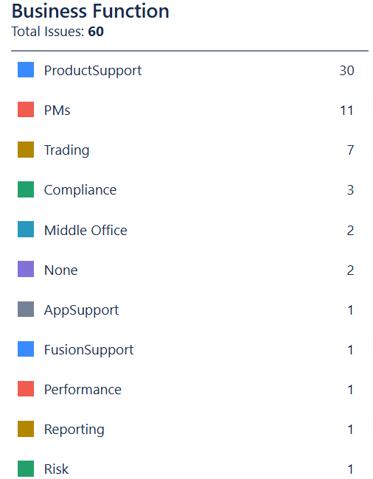
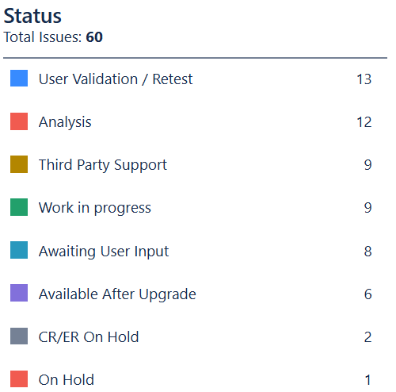
Fusion Support Update (January 2025)
Tickets distribution per Business Unit (day of report)
Tickets status (day of the report)

Slide 3
Fusion Support Update (January 2025)
Open Incidents per Business Unit (day of report)

Slide 4
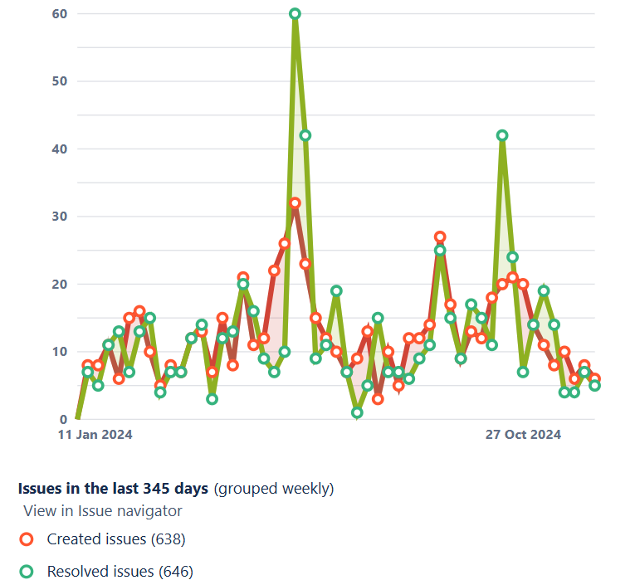
Fusion Support Update (January 2025)
Incidents Created vs Resolved Year to Date

Slide 5
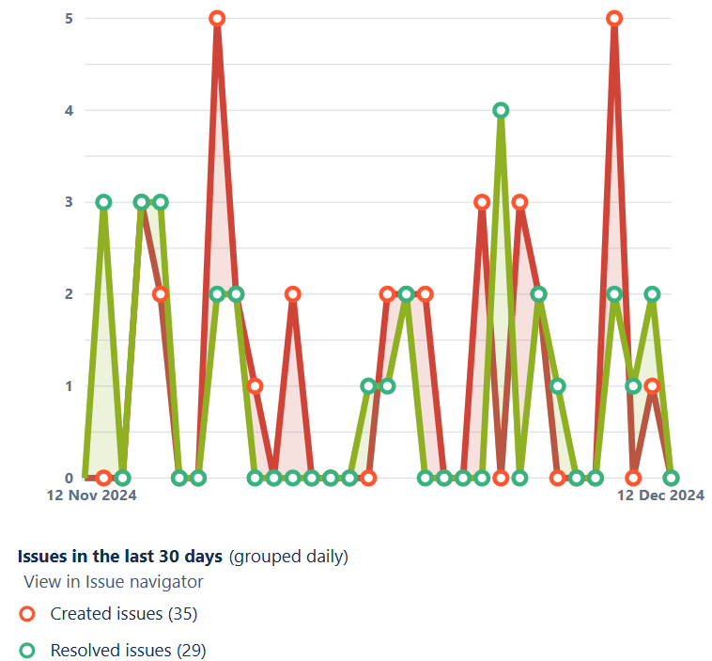
Fusion Support Update (January 2025)
Incidents Created vs Resolved last 30 days

Slide 6
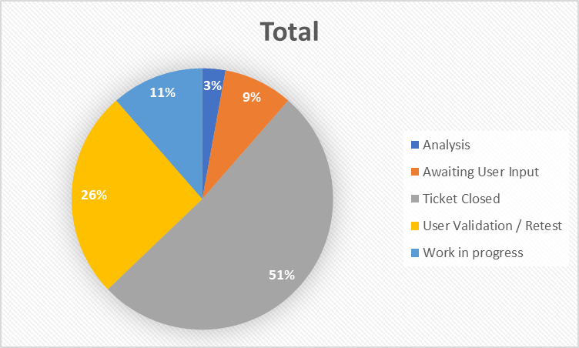
Fusion Support Update (January 2025)
Current Status of Tickets Created last 30 days per Business Unit

Slide 7
Fusion Support Update (January 2025)
Priority List
Summary | Priority | Status | Sub-Status | Key
CRT LN Equity on DF Morgan Stanley Property fund | High | Awaiting User Input | Awaiting User Input | FUS-3312
Trades in "Waiting for acceptance" status | High | Work in progress | Work in progress | FUS-3304
Initial Margin not being reflected in Cash Account | Medium | User Validation/Retest | User Validation/Retest | FUS-3303
Cash dividends in Refinitiv Ca file not created in Fusion - Ex-date 29/11/2024 - ISINs US12503M1080 and US31946M1036 | High | User Validation/Retest | User Validation/Retest | FUS-3340
Tax that is applied on cash dividend | Medium | Third Party Support | Finastra | FUS-3103
FUSIONINVEST_SSRecon_POSITION not picking up the correct Market value for CDX under CUSIP BNGB7HP14 and BNGBB8SP3 | High | Third Party Support | Finastra | FUS-3205
Fusion Rebalancing | High | User Validation/Retest | User Validation/Retest | FUS-1546

Slide 8
Fusion Support Update (January 2025)
Old Tickets Overview
Tickets raised with Finastra

